Slide 1

Jazz Photo Album
Cross Oceans Music

Slide 2
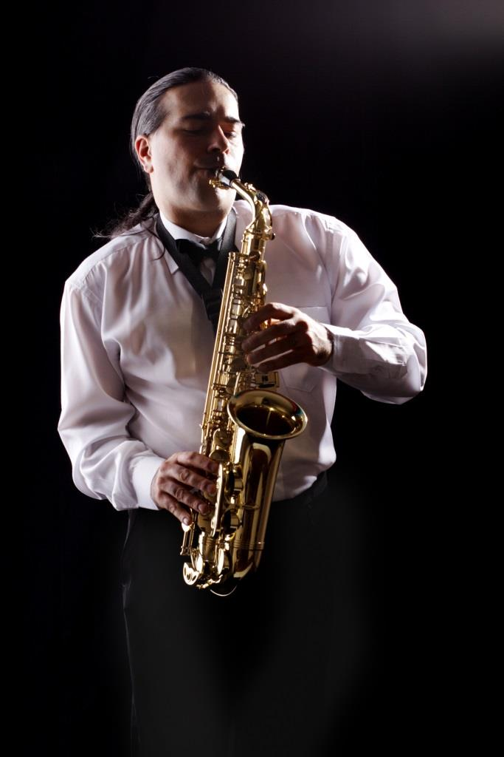
Alto Saxophone

Slide 3
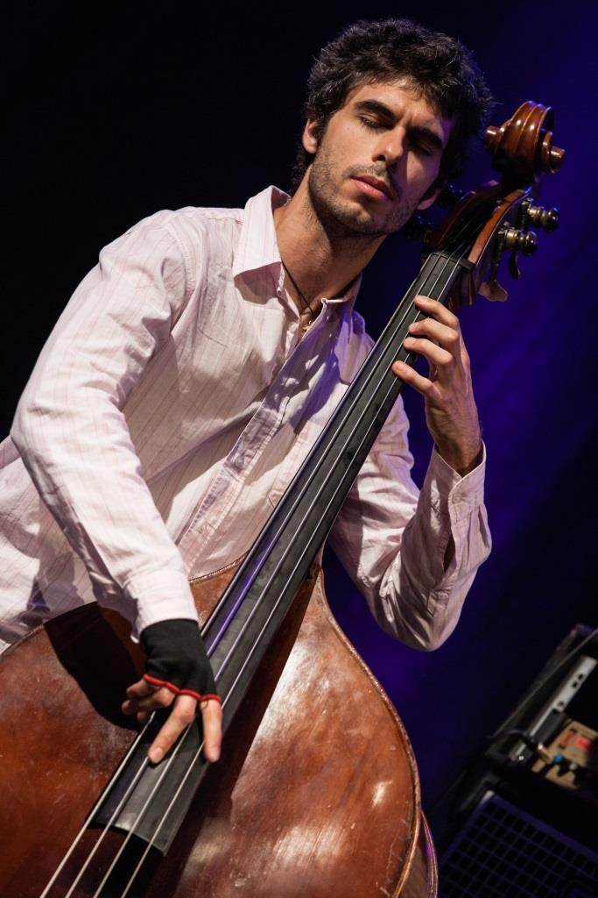
Bass

Slide 4
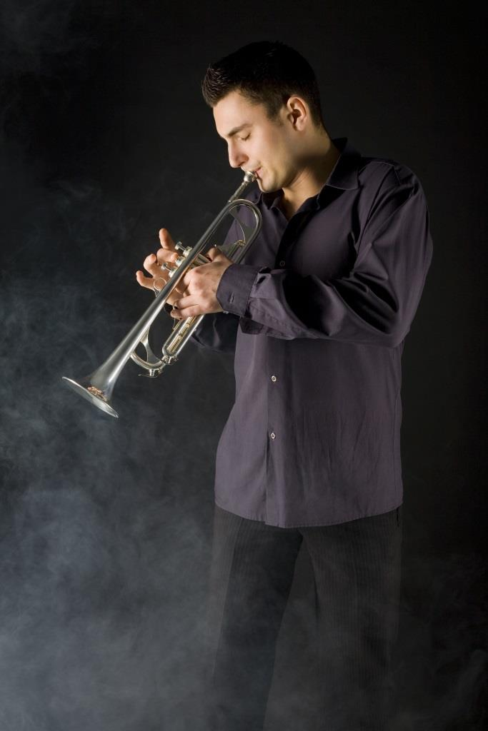
Trumpet

Slide 5
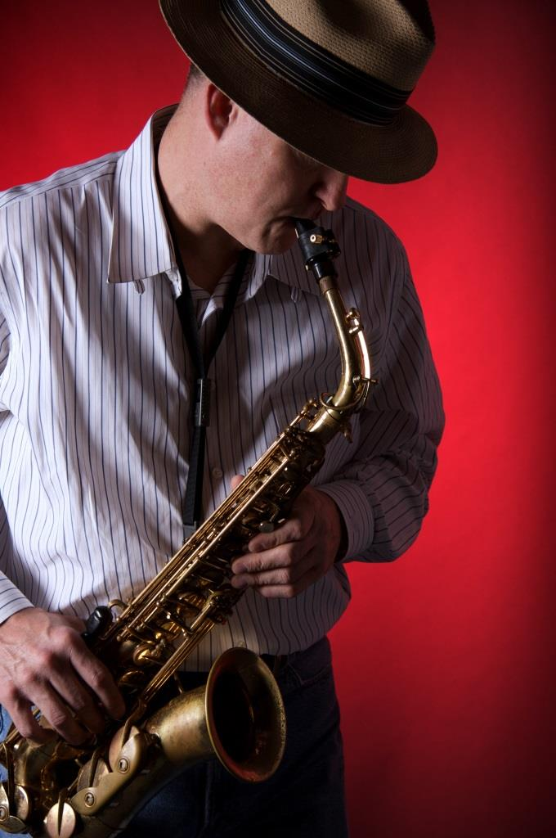
Alto Saxophone

Slide 6
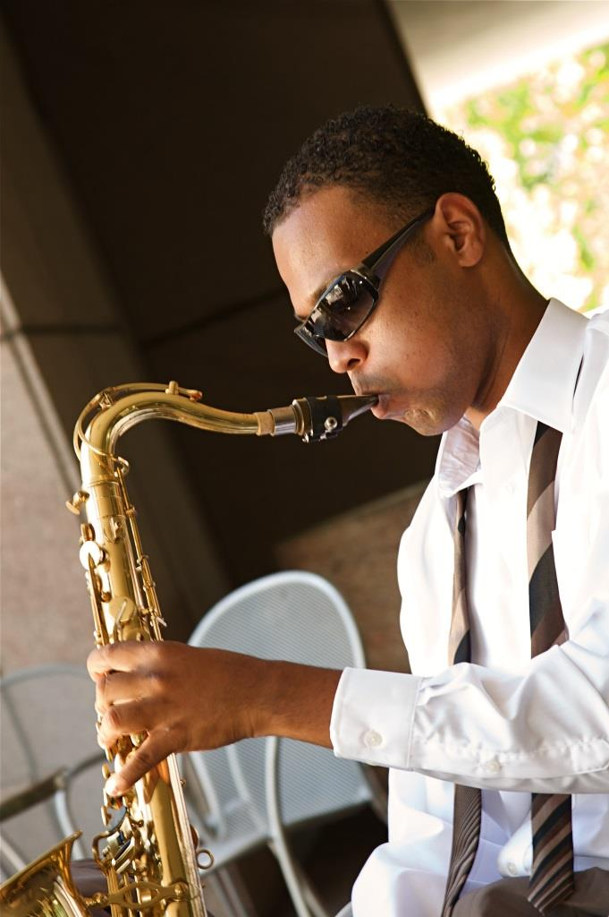
Tenor Saxophone

Slide 7

Meet our newest musician
James Todd
Alto Saxophone

